Slide 1
USSGL Account Ballot Items &
Upcoming Projects
USSGL Board Meeting May 1, 2024

Slide 2
Agenda
  Fiscal Year 2024 Ballot Items
  Fiscal Year 2025 Ballot items
  USSGL Scenarios
  USSGL Working Groups
  USSGL Issues Resolution
  Updates on Information provided at April IRC meeting

Slide 3
Fiscal Year 2024 Ballot Items - Modifications
119000 Other Cash
  This account is used to record the amount of cash holdings not otherwise classified in another USSGL account. This account does not include undeposited collections/deposits in transit, which should be reported in USSGL account 111000. This account also excludes cash deposited in accounts outside of the U.S. Treasury, in non-Treasury General Accounts (TGAs), which should be reported in the appropriate FHOT account. This account does not close at yearend.
  Justification: Ensures Funds Held Outside of Treasury (FHOT) are recorded in the appropriate cash SGL and reported in the Central Accounting and Reporting System (CARS) with the appropriate BETC.
120000 Foreign Currency
  This account is used to record the amount of U.S. dollar equivalent of foreign government currency. By nature, this account includes foreign currency deposited in accounts outside of the U.S. Treasury, in non-Treasury General Accounts (TGAs.) This account does not close at year-end.
  Justification: Ensures Funds Held Outside of Treasury (FHOT) are recorded in the appropriate cash SGL and reported in the Central Accounting and Reporting System (CARS) with the appropriate BETC.

Slide 4
  Fiscal Year 2024 Ballot items - Modifications
299100 Other Liabilities
  This account is used to record other liabilities of reductions where there is not a related budgetary obligation. Use while awaiting a warrant to be issued for a reduction (i.e., rescission, across-the-board reduction, and sequestration). This account may also be used while awaiting a warrant to be issued for a reduction of unobligated balances of indefinite appropriations derived from the General Fund of the U.S. Government. The warrant must be issued by year-end. Also use this account where reductions are awaiting being processed via a capital transfer. This account does not close at year-end.
  Justification: To highlight that this USSGL can also be used for reductions awaiting being processed via capital transfer.

Slide 5
  Fiscal Year 2025 Ballot items - Additions
417112 Non-Allocation Transfers of Invested Balances – Receivable – Prior-Year
417212 Non-Allocation Transfers of Invested Balances – Payable – Prior-Year
417312 Non-Allocation Transfers of Invested Balances – Transferred – Prior-Year
  Justification: New USSGLs were necessary to separate prior-year from current-year. There is a need to show the receivable, payable, and transfer in a separate USSGL.

Slide 6
Fiscal Year 2025 Ballot items - Additions
423110 – Unfilled Customer Orders With Advance – Transferred – With Offset
  Definition: This account is used to record the amount in USSGL account 422200, "Unfilled Customer Orders With Advance," transferred from one Treasury Appropriation Fund Symbol to another where advance is offset by an unpaid obligation or an undelivered prepaid/advanced obligation. Although the normal balance for this account is credit, it is acceptable for this account to have a debit balance.
  Justification: To create new USSGL account for use in transferring unfilled customer orders with advance and offset by an unpaid obligation or undelivered prepaid/advanced obligation as needed in the draft Non-Expenditure Transfer Scenario.

Slide 7
Fiscal Year 2025 Ballot items - Modifications
416500 - Allocations of Authority - Anticipated From Invested Balances - Current-Year
416600 - Allocations of Realized Authority - To Be Transferred From Invested Balances - Current-Year
416700 - Allocations of Realized Authority - Transferred From Invested Balances - Current-Year
  Justification – To modify USSGL account series to separate prior-year (416512, 416612, and 416712) from current-year.
  Note – USSGL 416700 also has added to the definition a sentence reading “For situations where the executing TAFS has indefinite authority, the amount transferred must be obligated.

Slide 8
Fiscal Year 2025 Ballot items - Modifications
416512 - Allocations of Authority - Anticipated From Invested Balances - Prior-Year
416612 - Allocations of Realized Authority - To Be Transferred From Invested Balances - Prior-Year
416712 - Allocations of Realized Authority - Transferred From Invested Balances - Prior-Year
  Justification – To modify USSGL account series to separate prior-year from current-year (416500, 416600, and 416700) and to remove the “Corps of Engineers – Civil Works use only.” These USSGLs will be used by the Department of Interior and a GTAS validation will be added to limit access.
  Note – USSGL 416712 also has added to the definition a sentence reading “For situations where the executing TAFS has indefinite authority, the amount transferred must be obligated.”

Slide 9
Fiscal Year 2025 Ballot items - Modifications
417100 Non-Allocation Transfers of Invested Balances - Receivable - Current-Year
417200 Non-Allocation Transfers of Invested Balances - Payable - Current-Year
417300 Non-Allocation Transfers of Invested Balances - Transferred - Current-Year
  Justification: Modify USSGL account to separate prior-year (417112, 417212, and 417312) from current-year existing accounts.

Slide 10
Fiscal Year 2025 Ballot items - Modifications
423100 – Unfilled Customer Orders With Advance – Transferred – No Offset
  Definition: This account is used to record the amount in USSGL account 422200, "Unfilled Customer Orders With Advance," transferred from one Treasury Appropriation Fund Symbol to another where advance is not offset by an unpaid obligation or an undelivered prepaid/advanced obligation. Although the normal balance for this account is credit, it is acceptable for this account to have a debit balance.
  Justification: To update USSGL account 423100 for use in transferring unfilled customer orders with advance and they are not offset by an unpaid obligation or undelivered prepaid/advanced obligation as needed in the draft Non-Expenditure Transfer Scenario.

Slide 11
USSGL Scenarios
Coordinating with OMB to address budgetary guidance
  Non-Expenditure Transfers
  Congressional Deferral
  Executive Branch Deferral
  Year-End Accruals
  Rescissions/Reductions
  Repayable Advances
  Foreign Military Sales
  The U.S. Standard General Ledger - USSGL Implementation Guidance (treasury.gov)

Slide 12
USSGL Working Groups
Working Groups
  Custodial Guidance
  OMB Abnormal Balance Resolutions
  Budget and Accrual Reconciliation (BAR) Guidance
  Cash & Investments Held Outside of Treasury (CIHO)/Funds Held Outside of Treasury (FHOT)
  Intra-governmental Transactions (IGT) Buy/Sell
  Standardized Financial Statements

Slide 13
USSGL Working Issue Resolution
Issues Resolution
  Online issues log
  https://www.fiscal.treasury.gov/ussgl/report-an-issue.html
  USSGL Issues Template
  ussgl-issues-submission-template.docx (live.com)

Slide 14
Updates After April IRC Meeting
Update to Allocation of Realized Authority – To Be Transferred From Invested Balances – Prior-Year (416612) Definition
  For Corps of Engineers – Civil Works this account reflects activity that must adjust to zero before period 12 ATB submission.
Validation 37 (Period 12 Zero Balance Validation) Update
  USSGL 416612 will be removed from Validation 37 for FY 2025 reporting

Slide 15
Updates After April IRC Meeting
SF 133 – Line 1722 Update
  For USSGL 439300 with the Reimbursable indicator the Fund type is being updated to include EG & ER (General Fund or Intragovernmental Revolving Fund)
Transaction Code Modification/Additions
  A712 – Replace Ordering entity with performing agency
  D436 – To adjust this TC to apply to special or trust fund receipts also (for prior year)
  D437 (New) – Similar to TC D436 but only for current year and only for refund of offsetting collections other than advances
  D438 – For trust or special fund receipts in current year
  A147 – See next slide

Slide 16
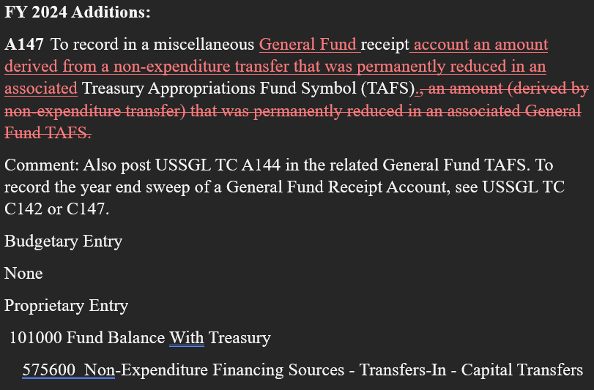
Updates After April IRC Meeting

Slide 17

Stephen Riley
Department of the Treasury
Bureau of the Fiscal Service
(304) 480-7536
Stephen.Riley@fiscal.treasury.gov
USSGL.Issues@fiscal.treasury.gov
Josh Hudkins
Department of the Treasury
Bureau of the Fiscal Service
(304) 480-7602
Joshua.Hudkins@fiscal.treasury.gov
USSGL.Issues@fiscal.treasury.gov
USSGLteam@fiscal.treasury.gov

