Slide 1
G-Invoicing Program
USSGL Board Meeting
May 1, 2024

Slide 2
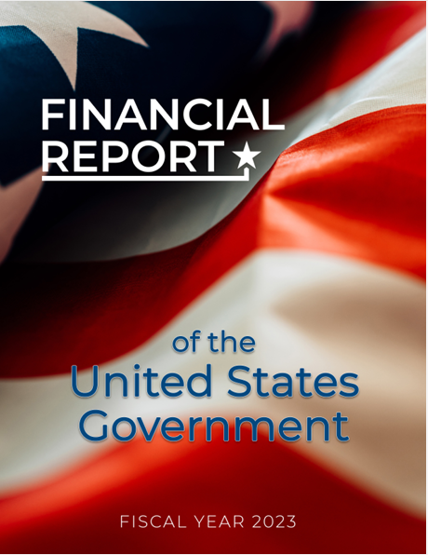
The Audit of the Financial Report of the U.S. Government
The Audit Issue
Since 1997, the Financial Report of the U.S. Government has consecutively received a disclaimer of opinion from the Government Accountability Office (GAO).
The inability to resolve differences in intra-governmental activity and balances between federal entities is a significant impediment to receiving an opinion.
For FY 2023, IGT Buy/Sell differences totaled $16.54 billion, which was the largest contributor to IGT differences.

Slide 3
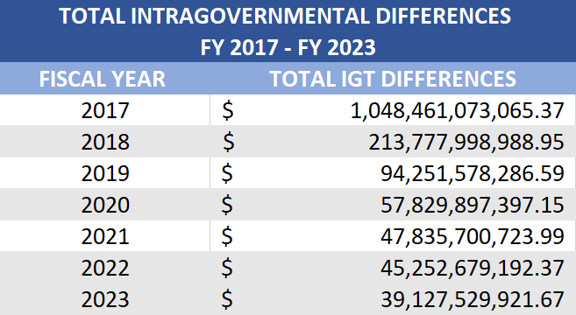
Intra-governmental Reconciliation Progress
Total Intra-governmental Elimination Differences have steadily decreased each fiscal year.

Slide 4
What Are the Largest Outstanding Intra-governmental Differences?

Slide 5
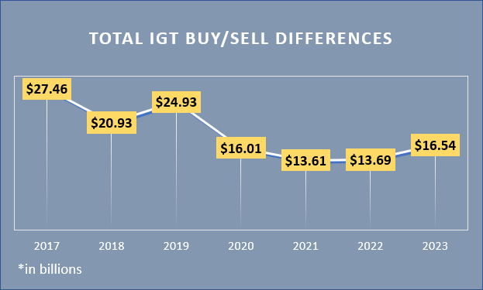
IGT Buy/Sell Differences Trend
The IGT Buy/Sell Sub-Category remains the largest contributor to differences.
FY 2023
Total IGT Differences
$39.13 billion
IGT Buy/Sell Differences
$16.54 billion
42%
Agencies’ cited reasons for differences include:
Financial Management Systems Issues (38%)
Communication/Timing Issues (26%)
Conflicting Accounting Methodology (7%)
Reporting Errors (2%)

Slide 6
G-Invoicing Program Overview
What is G-Invoicing?
Long-term solution for Federal Program Agencies to manage their IGT Buy/Sell transactions and improve the quality of IGT data.
Key Attributes:
Data
Policy
The Federal Intra-governmental Data Standard (FIDS) serves as the foundation for the process and policy standardization activities
New and clarified guidance relating to IGT Buy/Sell processing, accounting, and reporting
Benefits Provided:
Promote Federal Trading Partner Communication
Improve the Quality and Reliability of IGT Buy/Sell Data
Reduce Adjustments
Facilitate Reconciliation and Elimination
Improve Transparency & Accountability
Process
Standardized system solution where Federal Trading Partners can broker and exchange information in support of common accounting treatment
G-Invoicing Mandate – Treasury Financial Manual – Chapter 4700, Appendix 8
The mandated implementation deadline was October 1, 2022, for New Orders and includes Orders with a Period of Performance beginning October 1, 2022, or later.
All IGT Buy/Sell activity must be implemented into G-Invoicing by October 1, 2025.
The IPAC application will remove the ability to initiate a transaction categorized as Buy/Sell on 10/1/2025.

Slide 7
G-Invoicing Delivery Methodology
We’ve Listened To Our Customers
In developing G-Invoicing, Treasury exercised a “customer first” approach, leveraging user centered design and numerous working groups to drive collaboration with Agency Stakeholders and ERP Financial System Providers.
We’ve Stayed Focused On Improving Financial Management
The vision for a data broker and repository, built on the foundation of a Federal Intragovernmental Data Standard, has been a guiding principle of this initiative.
We’ve Been Transparent In Our Efforts
The development of G-Invoicing was an iterative, collaborative process during which Treasury consulted with federal agencies, Enterprise Resource Planning (ERP) vendors, and the Office of Management and Budget, leveraging customer experience best practices to implement a solution that reflects the collective voice of the users.
We’ve Remained Flexible In Our Approach
We’ve adjusted our scope, re-aligned our mandates, and added capabilities to the solution that were not originally envisioned to better support the business needs of IGT Buy/Sell Trading Partners.
Rather than just delivering a new offering TO our customers, we have collaboratively built it WITH them.

Slide 8
What G-Invoicing Will Deliver
Supports Federal Agencies in the standardized exchange of goods and services within the Federal Government by serving as communication platform and a clearinghouse solution regardless of ERP Provider.
Provides accurate and timely visibility into Federal Agencies’ transactions with each other, apprising both parties of the status of their orders and deliveries, tying movement of funds to deliveries and receipts.
Most importantly, as a transparent transaction broker, G-Invoicing ensures that proper financial information is available to all Agencies to facilitate the correct accounting treatment and in support of auditing
G-Invoicing will support improved financial management of Intragovernmental transactions by Federal Agencies through improved data accuracy, integrity, and transparency.

Slide 9
What does the GAO Independent Auditor’s Report state?
As noted in the FY 2023 Government Accountability Office Independent Auditor’s Report:
“Significant progress has been made over the past several years, but the federal government continues to be unable to adequately account for intragovernmental activity and balances between federal entities.”
“While progress was made, auditors for several significant component entities continued to report that the entities did not have effective processes for reconciling intragovernmental activity and balances with their trading partners.”
As a result, Treasury and Office of Management and Budget (OMB) will continue to monitor raw intra-governmental data from entities. Additional assurances are needed to ensure appropriate IGT controls are in place.
Addressing the intragovernmental transactions problem remains a difficult challenge and will require federal entities’ strong and sustained commitment to resolving differences.

Slide 10
G-Invoicing CFO Memorandum
Fiscal Service recognizes that full compliance with the G-Invoicing Treasury Financial Manual (TFM) mandate is an extensive effort requiring strong collaboration amongst Federal Agencies and Enterprise Resource Planning System Vendors.
Full compliance with the G-Invoicing TFM mandate and the October 1, 2025 IPAC deadline is expected of all Federal Trading Partners who broker IGT Buy/Sell transactions.
A memorandum to all Federal Chief Financial Officers reinforcing the mandated use of G-Invoicing and the planned IPAC FY2026 cutoff has been drafted and is currently in coordination for signature by the Fiscal Assistant Secretary of the Treasury and the Office of Management and Budget.

Slide 11
G-Invoicing Production Data – Government-wide
March 31, 2024
Disclosures
The percentage of dollars chart reflects a comparison of buy/sell activity facilitated in G-Invoicing versus directly in IPAC.
Due to enhancements in the IPAC application, Fiscal Service is collecting improved data to better differentiate buy/sell vs non-buy/sell activity through the IPAC application. This can reflect a lower percentage of dollars despite the actual dollars facilitated through G-Invoicing increasing.

Slide 12
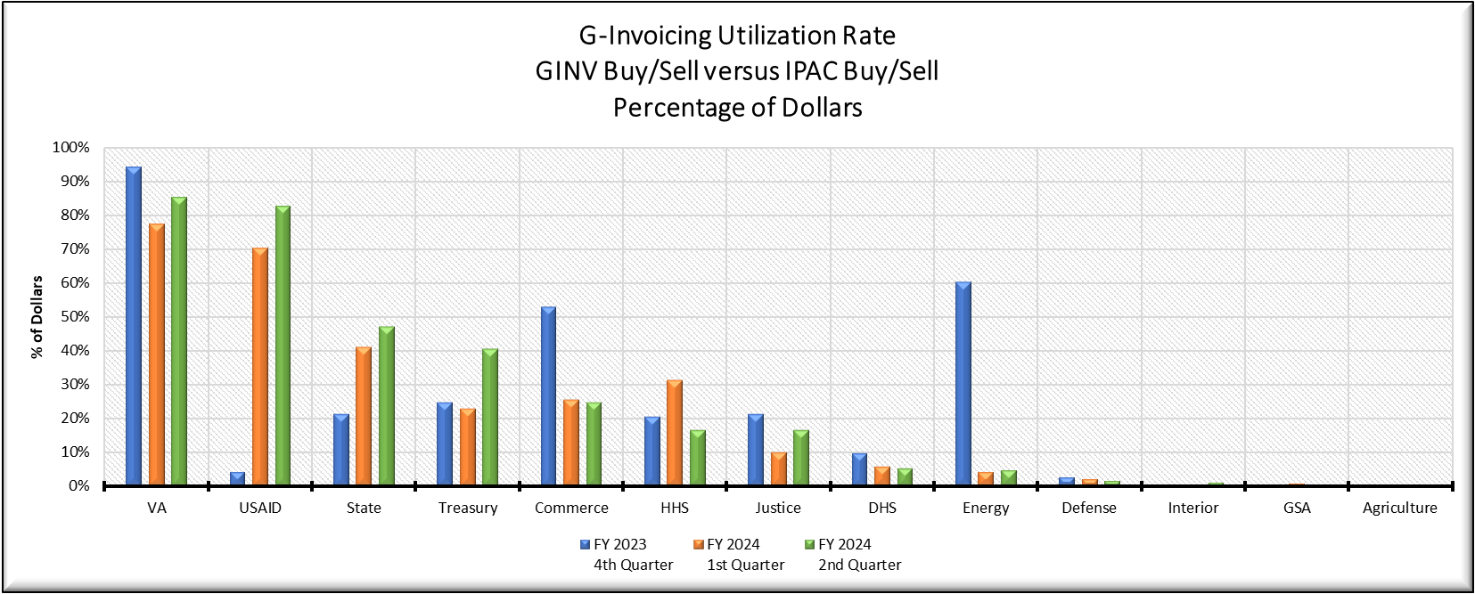
G-Invoicing Production Data – Target 13 Agencies
March 31, 2024
Disclosures
The percentage of dollars chart reflects a comparison of buy/sell activity facilitated in G-Invoicing versus directly in IPAC.
Trading Partner Readiness continues to significantly impact agencies that have successfully implemented G-Invoicing.

Slide 13
G-Invoicing Program Status
Treasury Financial Manual Chapter 4700
FY24 update was published on November 16, 2023
Codifies the removal of the In-flight Order Conversion Mandate
Re-affirms IPAC cutoff at the end of FY25 (IGT Buy/Sell subcategory removal)
Business Enhancement Requests for G-Invoicing
In response to CFO Council feedback, enhancement requests for G-Invoicing will be limited while agencies continue efforts to successfully onboard G-Invoicing.
ERP Vendor Engagement
Treasury has a regular cadence of individual working sessions with ERP vendors to ensure they have a full understanding of G-Invoicing functionality and to address their development teams’ questions.

Slide 14
Connecting With Your Trading Partners
Staying up to date on your Partners’ progress is key to your own success in transitioning your IGT Buy/Sell activity to G-Invoicing. Fiscal Service provides several utilities to facilitate effective communication with your Partners to gain an understanding of their implementation approach and timeline.
Intra-governmental Transactions Working Group (ITWG)
A monthly venue for FPAs to review, discuss and provide feedback on the requirements and functional/technical design of the G-Invoicing solution, and related IGT Policy. Learn more here: https://www.fiscal.treasury.gov/g-invoice/
G-Invoicing Office Hours
Bi-monthly sessions allow FPAs to engage with Treasury and their Trading Partners on a variety of G-Invoicing and IGT Buy/Sell topics. Agency-specific Office Hours allow FPAs to learn about specific implementation approaches being conducted by key Buy/Sell Partners. Register for office hours here: https://fiscal.treasury.gov/g-invoice/training.html
Training Webinars - Focus Groups - User-Centered Design – Self-Guided Learning
To learn more about these options available to Trading Partners, and to receive direct engagement with our Agency Implementation Team, contact us at IGT@fiscal.treasury.gov Or visit our website: https://www.fiscal.treasury.gov/g-invoice/
Agency Implementation Plans and Points of Contact
USDA’s Connect.gov page contains data related to Agency’s Implementation Status including Implementation Plans for CFO Act Reporting Entities who receive IGT Scorecards. https://community.connect.gov/display/CrossAgencyExternal/Bureau+of+the+Fiscal+Service+G-Invoicing
14

Slide 15
Reference Materials
Policy:
TFM Chapter 4700 – Appendix 8
Published:
November 2023 (Updated Annually)
Guidance:
G-Invoicing Program Guide for
Basic Accounting and Reporting
Revised:
August 2022
G-Invoicing System Integration
Guide
Revised:
May 2023
G-Invoicing Rules of Engagement
Revised:
July 2023
The Mandate
Mandated that all Federal Program Agencies (FPAs) who process IGT Buy/Sell transactions must implement G-Invoicing. https://tfx.treasury.gov/tfm-classic/volume1/part2/chapter-4700-federal-entity-reporting-requirements-financial-report
TFM Bulletin 2023-05 (March 23, 2023) Defined revised timeline for IPAC IGT Buy/Sell Subcategory Use, IGT Scorecard Updates, and Constructive Order Acceptance restrictions. https://tfx.treasury.gov/tfm/v1/bulletins/2023-05
TFM Bulletin 2023-10 (July 27, 2023) Eliminated the In-Flight Orders Mandate. https://tfx.treasury.gov/tfm/v1/bulletins/2023-10
Program Guide
Provides guidance regarding proper accounting treatment for IGT Buy/Sell transactions processed through G-Invoicing https://www.fiscal.treasury.gov/ussgl/resources-g-invoicing-program-guide.html
System Integration Guide
Details how FPAs may utilize automated data exchanges to communicate IGT Buy/Sell activities to/from G-Invoicing
https://fiscal.treasury.gov/files/g-invoice/g-invoicing-system-integration-guidev1.1.pdf
Rules of Engagement
Outlines protocol for Trading Partner interaction in support of transitioning IGT Buy/Sell business processes to G-Invoicing
https://www.fiscal.treasury.gov/files/g-invoice/g-invoicing-rules-of-engagement.pdf
Federal Intra-governmental Data Standards (FIDS)
Defines the data attributes and the system mapping & validation rules for the new IGT Buy/Sell data standard which is implemented through G-Invoicing.
https://fiscal.treasury.gov/g-invoice/resources.html#standards

Slide 16
G-Invoicing Program Support and Contacts
For IGT Program Management and Agency Outreach Support
Andy Morris
Manager, Intragovernmental Transaction & Reconciliation Branch (ITRB)
Bureau of the Fiscal Service – Fiscal Accounting
Andrew.R.Morris@fiscal.treasury.gov
Jeff Board
G-Invoicing Product Owner, ITRB
Bureau of the Fiscal Service – Fiscal Accounting
Jeffrey.Board@fiscal.treasury.gov
Keith Jarboe
IGT Agency Outreach, Engagement & Onboarding
Bureau of the Fiscal Service – Fiscal Accounting
Keith.Jarboe@fiscal.treasury.gov
For Intragovernmental Transactions Working Group Information
IGT@fiscal.treasury.gov
https://www.fiscal.treasury.gov/g-invoice/
For G-Invoicing Application Support
GInvoicing@stls.frb.org
1-877-440-9476

